Slide 1
THE VALUE OF 168
Jessica Bieszczak
Shelley Earl
Caroline Watson
19th April 2022
Investigation Workshop

Slide 2
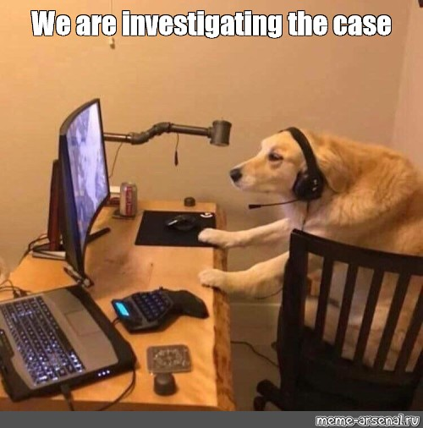
Presentation Format
Introductions and polling questions
Triggers for internal investigations
Investigation Scenario
The initial complaint
The investigator
Unconscious bias
Planning
Document and Physical Evidence Review
Interviewing
Non-retaliation Policy
Report writing
Taking action

Slide 3
POLLING INSTRUCTIONS
Today’s presentation will have polling questions, watch for the slides with the pink question mark cards to answer a question.
TEST
How good do you think your knowledge is with regards to conducting investigations?
Very Good
Good
Fair
Not Great
Poor

Slide 4
Internal Investigations - Triggers
What can trigger an Inquiry or Investigation?
Internal Triggers
Complaint by employee
Observations
Incident
Hotline call
External Triggers
3rd party complaint
Government
Hotline call
News story
Social media
Incident

Slide 5
Investigation Scenario
Nick
Catherine
Brad
Joyce
Plant Operator
Plant Operator
Plant Supervisor
HR Manager
Nick has been with the business in the production department for 12 years
Catherine joined the business last year as a plant operator
Nick and Catherine both report to Brad. Brad has been with the company for 13 years
Joyce is the HR Manager on site, she has been with the business for 8 years.

Slide 6
Investigation Scenario
Catherine is a Plant Operator in one of our facilities, she goes to see Joyce the HR Manager to raise a concern:
“I want to raise an issue, my workstation has been moved by Brad to Station 5, I don’t really like being at the new station it is next to Nick and he stares at me”
“Thanks for letting me know I will ask Brad about it”

Slide 7
Investigation Scenario
Joyce calls Brad to discuss Catherine’s complaint and explains Catherine’s concerns:
“I moved Catherine to station 5 as she was not being very productive, Nick is one of my best guys he has been here for over 10 years, and he can keep an eye on her”
“Thanks for filling me in on the situation with Catherine’s performance, I will close the issue”
Joyce puts the incident down to a small disagreement, she does not document the issue and does not provide feedback to Catherine

Slide 8
POLLING QUESTION 1
Do you think Joyce did anything wrong in this scenario?
She did not fully evaluate if an investigation was needed
She did not document the complaint
She did not report back to Catherine
All of the above

Slide 9
POLLING QUESTION 1 - ANSWER
Correct answer would be 4 – All of the above
Joyce could have handled the situation better by:
Documenting the complaint
Discussing the complaint further with Catherine to see if further investigation was needed
Reporting back to Catherine
Reviewing the personnel files of the employees, was there any note of performance issues for Catherine, or previous concerns in relation to Nick’s behaviour?
Joyce likely relied too heavily on Brad’s opinion and his comment on poor performance.

Slide 10
Investigation Scenario – 4 weeks later
4 weeks after Catherine’s initial complaint she revisits Joyce:
“Nick makes me uncomfortable he says things about how nice I look, or compliments my hair, or says let me carry that as ‘you are only a women’. He will then laugh and say he is only joking, but I don’t feel like it is a joke.”
“My supervisor Brad has witnessed this kind of behaviour but he does not say anything, I think they are good friends, they spend a lot of time with each other and go on vacation together.”
“At first Nick’s comments did not bother me too much but now it is getting more frequent, he still stares at me all the time and it seems to have got worse since I made the complaint last month.”
“I don’t want anyone to get into trouble, I like my job and I need to keep it, I just want it to stop.“
Catherine – The Reporter
Joyce decides that she needs to look into Catherine’s complaint in more detail

Slide 11
POLLING QUESTION 2
Should Joyce report this as a Reportable Event?
No
Yes – report when Catherine raised the initial complaint about the workstation
Yes – report when Catherine made the latest complaint
Yes – report after the investigation is concluded with the findings
Maybe – report dependent on the outcome of the investigation

Slide 12
Reportable Event – if and when to submit?
It can be difficult to know when to submit a reportable event.
When you start thinking as part of an inquiry you may need to interview or gather data then it is an investigation which requires submitting a reportable event.
You should submit the RE within 24 hours - RPM International Inc. | Reportable Event Form (ethicspointvp.com)
The RPM Compliance team will review the Reportable Event and contact you if they require further information.
If in doubt – report
Remember that some allegations depending on the severity will trigger a reportable event in itself i.e. fraud, sexual harassment, workplace violence, theft.
Refer to Reportable Event Policy on Navigator for further details.

Slide 13
POLLING QUESTION 2 - ANSWER
In our scenario option 3 would be the best answer. Yes – report when Catherine made the latest complaint
Had Joyce followed up with Catherine at the start of the scenario and asked more questions she may have decided to trigger an investigation earlier.

Slide 14
Investigation Scenario
Joyce submits a Reportable Event to RPM and starts planning the investigation.
She needs to determine the full scope of the investigation and who is going to investigate.
Planning the initial steps of the investigation can be very helpful.
REMEMBER – Determine if any immediate action is needed for the safety of people or the company. Access to systems, passes/keys etc. If unsure ask the RPM Compliance team.

Slide 15
POLLING QUESTION 3
Do you think Brad, the Plant Supervisor could help to investigate?
Yes
No
Maybe

Slide 16
The Investigator – who should it be?
The Primary role of the investigator is to conduct, a thorough, unbiased, objective review of the complaint and the facts alleged to determine what transpired.
Investigator should be neutral.
Look for evidence that could be inculpatory or exculpatory.
Should the investigator be internal or external? Will depend on who, what, where?
Take each complaint seriously and let the evidence lead to the conclusion – we have a duty to investigate under V&Es of 168.
Notes:
Investigator should not be trying to vindicate the company, officers, employees, etc., nor should they be out to get anyone.
Look for evidence that could be inculpatory (shows or tends to show involvement in an act) and/or exculpatory (evidence that shows or tends to show exoneration).
Avoid allowing “cognitive bias” to adversely effect the investigation, i.e., don’t jump to conclusions, make sure you seek out objective facts, don’t interpret information to support your existing belief.
Take each complaint seriously and let the evidence lead to the conclusion – we have a duty to investigate under V&Es of 168\\Should the Investigation be conducted by an employee, or should the company hire an outside investigator.
Factors to consider
Nature and scope of the complaint
Is it something that could pose a substantial financial risk to the company or result in a mandatory disclosure to a government agency? If either of those things are true, an outside lawyer is usually needed.
Could it involve a criminal violation? Securities fraud, destruction of records, falsifying government filings, theft, bribery, insider trading, etc.?
Does the complaint involve an officer or senior manager of the company?
Is there a skilled, unbiased employee capable of conducting the investigation?
Is there a need to preserve attorney/client privilege?
Is it a routine HR matter that you can conduct? Does it involve someone you are friends with or is within your chain of command?
Can the investigator potentially be a witness and what kind of witness?
Is there a Union

Slide 17
The Investigator – Unconscious Bias
Avoid allowing “unconscious bias” to adversely effect the investigation, i.e., don’t jump to conclusions, don’t interpret information to support your existing belief.
Confirmation bias
‘Like me’ bias
Priming bias
Notes:
Investigator should not be trying to vindicate the company, officers, employees, etc., nor should they be out to get anyone.
Look for evidence that could be inculpatory (shows or tends to show involvement in an act) and/or exculpatory (evidence that shows or tends to show exoneration).
Avoid allowing “cognitive bias” to adversely effect the investigation, i.e., don’t jump to conclusions, make sure you seek out objective facts, don’t interpret information to support your existing belief.
Take each complaint seriously and let the evidence lead to the conclusion – we have a duty to investigate under V&Es of 168\\Should the Investigation be conducted by an employee, or should the company hire an outside investigator.
Factors to consider
Nature and scope of the complaint
Is it something that could pose a substantial financial risk to the company or result in a mandatory disclosure to a government agency? If either of those things are true, an outside lawyer is usually needed.
Could it involve a criminal violation? Securities fraud, destruction of records, falsifying government filings, theft, bribery, insider trading, etc.?
Does the complaint involve an officer or senior manager of the company?
Is there a skilled, unbiased employee capable of conducting the investigation?
Is there a need to preserve attorney/client privilege?
Is it a routine HR matter that you can conduct? Does it involve someone you are friends with or is within your chain of command?
Can the investigator potentially be a witness and what kind of witness?
Is there a Union

Slide 18
POLLING QUESTION 3 - ANSWER
Do you think Brad, the Plant Supervisor could help to investigate?
The answer is 2. NO
Brad has already been noted by Catherine as a potential witness to Nick’s alleged behaviour.
Catherine has noted that she believes Nick and Brad to be friends – even if they are not friends there is perception of bias. There could be a potential Conflict of Interest here.

Slide 19
Internal Investigation The Game Plan
Who do you need to inform?
Identify list of witnesses
Identify potential sources of records.
Identify internal resources that can assist.
Must not be implicated, should be unbiased, and you should need their services.
Identify and review company polices and procedures that might be relevant.
Review any employee files and agreements.
Identify and Review training records that might be relevant.
Identify any past incidents
Keep in mind the need for safety and preserving evidence.
Your order or plan might change as the investigation progresses, so constantly review. Think it through.

Slide 20
POLLING QUESTION 4
Do you think there is any record review Joyce could do in this investigation?
Yes
No
Not Sure

Slide 21
Document and Physical Evidence Review
Don’t just think of emails and Microsoft office type records. Consider phone and text records, video tapes, pictures, physical evidence, etc.,
Keep in mind confidentiality/privacy rules – speak to Legal & Compliance to review Data Privacy implications
Confidential information
Trade secrets
Private personal information
Medical information.
Confidential information of others.
Keep in mind duty to preserve.

Slide 22
POLLING QUESTION 4 - ANSWER
Do you think there is any record review Joyce could do in this investigation?
Best answer would be answer 1. Yes
Whilst the circumstances of this scenario to date would likely rise to the main data gathering being interviews, don’t forget there may be other sources to review, such as:
Personnel file review
CCTV – is there cameras in the areas where the incidents may have taken place
Timecards
Policy review

Slide 23
POLLING QUESTION 5
In relation to our scenario with Catherine’s complaint - Who would you plan to interview first?
Brad (supervisor)
Catherine (reporter)
Nick (accused)

Slide 24
Interviewing
When do you begin interviewing witnesses?
First, gather as much documentary and physical evidences as you reasonably can, to assist you in questioning witnesses, and identify areas for inquiry.
Interview, if possible, the accuser/reporter first, so you can fully understand the complaint.
Interview other witnesses next before interviewing the accused.
Advantages of interviewing accused last
You get other witness statements early and before they might be influences by the accused, each other, office gossip, etc.,
They may identify additional information which could be helpful in questioning the accused.
You can identify all information against the accused, including additional relevant records, to allow you to do a comprehensive interview of the accused, addressing all relevant accusations and records, instead of going back multiple times
Advantages of interviewing accused before other witnesses
Accused might admit wrong- doing and avoid expensive investigation
Appearance of neutrality
First-hand source of information to help your evidence gathering.
Exculpatory Evidence (evidence that shows or tends to show exoneration).
Helps you in your interview of other witnesses.
Scheduling can sometimes cause issues with the interview order – you may need to adapt

Slide 25
POLLING QUESTION 5 - ANSWER
In relation to our scenario with Catherine’s complaint - Who would you plan to interview first?
Best answer in this scenario would be answer 2. Catherine
The order of interviews will depend upon the scenario. In many situations interviewing the reporter will most likely be the best course of action so you can document the allegations and help establish any document review or list of potential witnesses.
Remember that each investigation will be different based on the circumstances so make sure you review the best course of action.

Slide 26
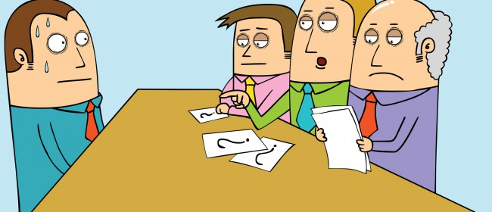
Interviewing
Do you conduct the interview alone or do you have another witness? We would recommend a witness.
Advantages
Two people, one questions the other can observe witness.
Verify what was said.
Advise interviewer of additional questions.
Assist with note taking
Disadvantages
Witness might get intimidated.
2nd person interrupts, buts-in.
How to do the interviews?
Do you have to warn the employee?
“Upjohn” warning for lawyers/non-lawyers.
How about for non-lawyers doing interview?
Duty to co-operate.
Request not to disclose or discuss?
Non-retaliation.
RPM guide for instructing witness.

Slide 27
Investigation Scenario – Catherine’s interview
“I think some people have already left the business due to Nick’s behaviour, there is an atmosphere that ‘this is how it is, it’s always been like this’ and Nick has been here a long time. It feels like he is untouchable especially due to his friendship with Brad, people feel that they cannot speak up.”
“I think Stephanie may have also experienced the same type of behaviour that I have from Nick, not sure if she has ever raised the issue.”
“I do feel that Nick’s behaviour has got worse since I made the complaint to you about the workstation. Nick leans over me whilst I am working, he has started asking me awkward questions about my relationship with my boyfriend, things like ‘is your boyfriend the best lover you have ever had?’ and then he says things like ‘ I am sure you could find better close by’.”

Slide 28
Investigation Scenario – Catherine’s interview
“Because of Nick’s actions people are starting to talk about us, as they notice his attention towards me and there are rumours, he insists on walking me to my car after the shift, he waits outside the ladies’ locker room. I have asked him to stop but he insists it is for my safety.”
“Do you know if anyone else has witnessed Nick’s behaviour? And do you know who started the rumours”
“Mario may have witnessed some of the behaviour he works really close by, he is very quiet.”
“On the rumours Nick has made comments to me that people have been saying we seem close, I have not heard anything

Slide 29
OPEN TEXT QUESTION 1
Do you think the initial investigation plan may now change based off the information given in Catherine’s interview? And if so, how?
Please put your answers in the comments box.

Slide 30
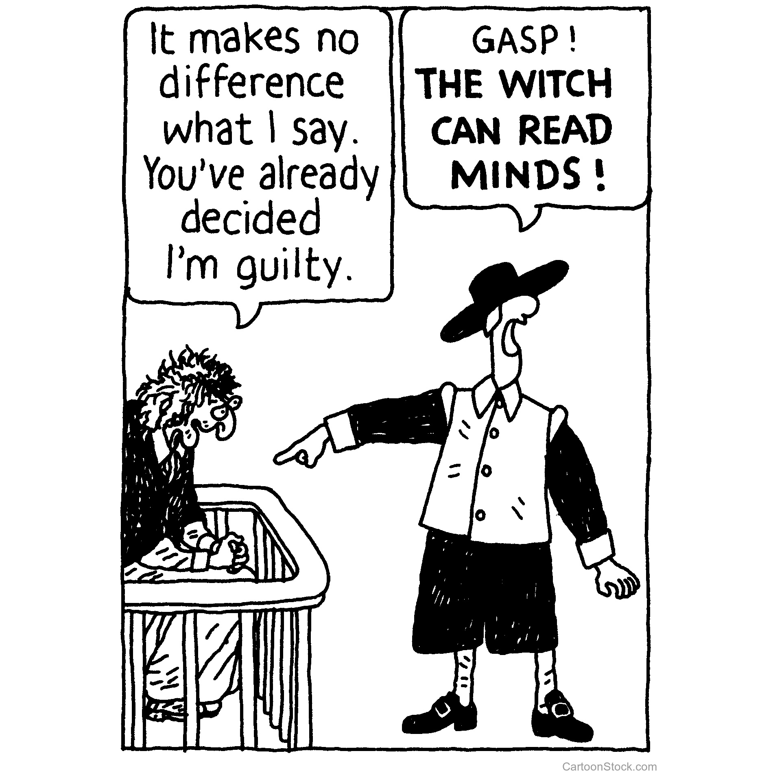
Interviewing
Do you record or take written notes of the interview?
Take written notes.
We would recommend against recording interviews – if you feel the need to record contact Legal and Compliance before moving forwards.
Where do you conduct the interview?
Consider location, privacy, off-site if risk of safety/confidentiality.
Consider how to handle remote witnesses.
Does the employee have the right to have someone with them? Need to consider:
Union/works council
A lawyer – usually not but check contracts
An interpreter
US – Does the employee have the right to plead the 5th amendment if potential criminal conduct is involved?
Notes:
Does the Employee have the right to have someone with them?
Another employee?
Union vs. non-union.
A lawyer?
Usually not, but check union contracts, company policies/ contracts
A parent?
Usually not, but does that change if the employee is a minor?
An interpreter?
Does the employee have the right to plead the 5th amendment if potential criminal conduct is involved?
Does not apply to questions by private employer.
Employee’s duty to cooperate
Disciplinary action.
Reasons for not cooperating? May help with the investigation if you know why.

Slide 31
Investigation Scenario - Stephanie’s Interview
Joyce decides to interview Stephanie next based on Catherine’s interview
“Hi Stephanie, Thank you for your time today we appreciate you speaking with us. There is no need to be concerned about meeting with us today.”
“We are conducting an investigation into allegations of inappropriate behaviour by a member of the team in the Production department and we believe that you may be a witness or have experienced similar behaviour yourself.”
Have you ever experienced or witnessed any behaviour that you have found to be inappropriate?”
Stephanie starts to cry…
“I am worried about losing my job, I am not sure I want to talk to you. You are asking too much I just want a quiet life.”

Slide 32
POLLING QUESTION 6
What do you think Joyce should do?
Respect Stephanie’s wishes and stop the interview
Remind Stephanie of RPM’s Non-retaliation policy and explain we cannot help if you don’t talk to us
Remind Stephanie that she has a duty to participate in an investigation
Give Stephanie the Hotline number in case she changes her mind

Slide 33
Interviewing
Conducting the interview
Explain who you are, what you are doing and who you work for.
Reveal as much information concerning the complaint as necessary.
If recording, get their consent on the record. Do not record without Legal and Compliance approval.
Explain to employee your desire to keep information confidential to preserve the integrity of the investigation but remember employee’s rights to discuss terms and conditions of employment. Can usually ask but not demand.
Explain non-retaliation policy.
Start by getting on the record their background, position, role in the company, duties, etc. Puts them at ease, gets the conversation going.
Conduct body of interview. Have a prepared outline of questions. Listen and adjust as necessary.
End by reminding them about purpose of interview and who you are, thanking them for their cooperation and ASKING them again to keep confidential and reminder of Non-retaliation policy.

Slide 34
POLLING QUESTION 6 - ANSWER
Best answer in this scenario would be answer 2. Remind Stephanie of RPM’s Non-retaliation policy and explain we cannot help if you don’t talk to us
Employees can often be fearful of opening up in interviews, they may have a real fear of losing their jobs, or being retaliated against in other ways.
We need to ensure that we provide a safe environment for the employee to speak up.

Slide 35
Investigation Scenario - Stephanie’s Interview
Stephanie agrees to speak to Joyce after Joyce provides more
comfort on the process and non-retaliation policy
“At first Nick was somewhat charming and light hearted, I start working on the same line as Nick about a year ago and he would say things like ‘you have a nice smile’.
“However Nick started making me feel more and more uncomfortable, he stared at me all the time and would ask about my husband and whether he made me happy, honestly it felt creepy and inappropriate.”
“He then started making comments about my butt, sometimes he would push past and graze my butt then say ‘oh sorry – but your husband really is a very lucky guy’,. It got worse when he started texting me with inappropriate comments including peach and love heart emojis. I still get some messages from him now.”
“I did go to Brad and raise my concerns, and he just said that ‘is just the way Nick is, he means no harm and you just need to get used to it’. When Brad did not do anything about it I felt there was no point raising it again, I was and am scared that I will be treated unfavourably, everyone seems to like Nick and Brad, they have been here a long time.”
“I really need this job, I asked to move to second shift so I don’t have to work with him, I really need the job. Second shift is not really good for me with my kids, but I felt I had no choice because of Nick’s behaviour.”

Slide 36
POLLING QUESTION 7
Is there anything Joyce should ask/discuss with Stephanie before closing the interview?
Request if Stephanie is able to provide any copies of the text messages from Nick
Ask if she can remember any of the dates of specific incidents she referenced
Ask if she is aware of any witnesses or other people who may have experienced similar behaviour
Ask if Stephanie ever confronted Nick about his behaviour
Ask if Stephanie was aware if Brad ever spoke to Nick about his behaviour
Remind Stephanie once again about the Non-retaliation policy and ensure Stephanie has Joyce’s contact details
All of the above

Slide 37
Assessing Witness Credibility
How do you assess a witness credibility?
Employees demeanor
Employees history
Plausibility of their statements, are they contradictory?
Interest in the outcome. What do they have to gain or lose by a certain outcome
Relationship to accused or accuser - bias
Corroboration
other testimony (credible).
Documentary or other evidence

Slide 38
POLLING QUESTION 7 - ANSWER
Best answer in this scenario would be answer 7. All of the above
It is important that without overwhelming the interviewee you gather as much information as possible during an interview. Whilst you can always bring the interviewee back in at a later date it is best to try and get as much in as possible – be aware though of time interviews can be stressful for the witness!
If the interviewee discussed records that may support their comments, ask for copies. If they are unable to provide them review if there are other ways to review those documents – be aware however of data privacy implications.

Slide 39
Records Review
Stephanie provides Joyce with a number of text messages she had received from Nick.
Stephanie is worried that her husband will be angry if he finds out the extent that Nick has been harassing her. He is already upset she moved shift.
Stephanie could not remember specific dates but it was over a month ago. Joyce is aware that CCTV footage is only kept for four weeks.
Stephanie thinks Mario may have witnessed some of the behaviour by Nick.

Slide 40
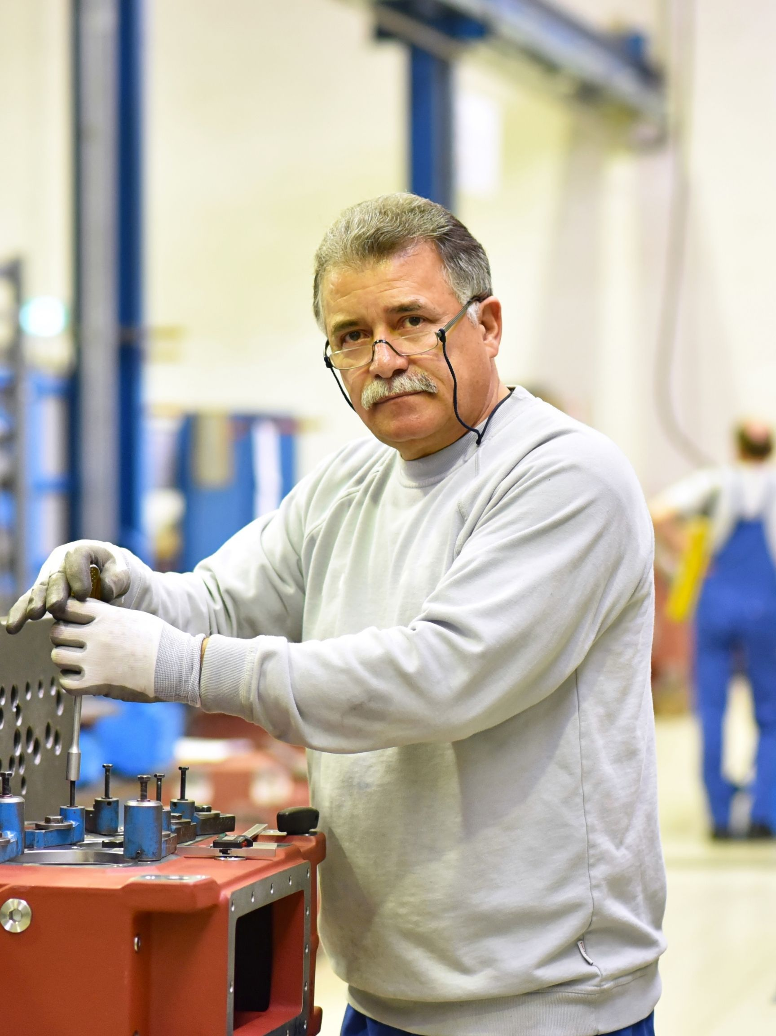
Investigation Scenario - Mario’s Interview
Joyce decides to interview Mario next and asks him if he has ever witnessed or experienced any inappropriate behaviour
“I have been here a long time, almost 30 years and I just want to keep my head down, I am due to retire in the next 5 years.”
“I do think Nick is often inappropriate, there is lots of banter with most employees, he definitely thinks of himself as a bit of a joker. He often jokes about me being slow on the line and will say ‘it is because I am old’ and will make comments like ‘Mario has been here for so long he has a parking space for his dinosaur’, I know his nickname for me is Fred as in Fred Flintstone as he thinks I am prehistoric. Some times when he thinks he is being really funny, he will call me F***stone”
“I really don’t want any trouble with Nick, I just want to work a few more years without any issues.”
“I have told the girls however that they should make a complaint about his behaviour. I have seen him with Stephanie, he used to spend a lot of time around her station, way more than he should. He does the same with Catherine, I am sure Stephanie asked to move because of Nick, although she would not say.”
“He seems to really focus on Catherine now, I have seen him walking her to her car, and she looks uncomfortable.”
“Nick and Brad so seem to get on well, but not sure how deep their friendship is, I often think Nick overplays it to try and avoid people raising issues to Brad.”

Slide 41
Investigation Scenario - Brad’s Interview Preparation
Brad could be a little defensive, it is likely that he is aware that HR have been interviewing team members – how would we best prepare for the interview questions?
Brad has been with the company for 13 years and has been promoted to supervisor a few years ago as he was one of the best workers on the line.
Whilst there have been concerns raised that Brad is friends with Nick, this is currently just hearsay so Joyce should not assume bias, but must be aware of this.
Questions for Brad’s Interview – open ended questions can be helpful:
Ask him about his role, tenure, team etc.
How does he think his team works together?
Good performers/Poor performers in the team
Any concerns related to relationship of individuals in the team?
Has anyone ever complained to him about a member of the team either from within the team or outside? If yes, what did he do? Did he report it to anyone else?
Has he ever witnessed any inappropriate behaviour in the team
Depending upon Brad’s responses Joyce could then focus on more specific questions, such as:
What is your relationship with Nick, do you see him outside of work?

Slide 42
Investigation Scenario - Brad’s Interview
Joyce sets out the questions she prepped for Brad’s interview.
“I think the team work generally well together, there is good banter, many of us have worked together on the floor a long time.”
“It could be said that sometimes it can get a little close to the edge on some of the comments, but it has always been like that. Nothing has changed in all the time I have worked here. We curse and joke, people have nick-names and I don’t think anyone really minds many of us are like family.”
“Nick is one of the jokers. I know he can rub people up the wrong way sometimes, but it is only messing around, he works hard and knows the line. I can trust him to do the job, we have worked together for so long.”
“I don’t really see Nick outside of work, he went to school with my brother so we have some history, but nothing more.”
“In terms of complaints, people complain all the time, ‘we don’t have enough resource’, ‘raws did not get here on time’, ‘CS messed up the order’, ‘ he stares at me’, ‘I don’t like the station I am on.’ “
“Stephanie did raise some concerns about Nick, but they seemed petty, he was staring at her and made her feel uncomfortable, nothing more than the everyday complaints I receive. I did not report these on, nor did I speak to Nick or HR about it”

Slide 43
Open Text Question 2
What concerns if any do you have related to Brad’s interview and his comments? Do you have any recommendations related to Brad as part of the investigation?

Slide 44
Investigation Scenario - Nick’s Interview
Joyce interviews Nick and asks him to respond to the allegations
Nick gets angry when asked by Joyce about the allegations.
“I am outraged that anyone would ever say these things about me, they are complete lies, I would never do anything like this, I am happily married with 3 kids.”
“I have worked for this company and given my everything to this business and this is what you accuse me of”
Nick calms a little and starts getting emotional
“I feel like this is a vendetta, there are people out on my line that are lazy and don’t know their jobs and they don’t like that I work so hard and pull them back into line. They are just jealous, because the supervisor and I are friends and everyone else likes me.”
“I don’t have anything more to say about the allegations, as they are all untrue, just dirty lies made up by jealous people.”

Slide 45
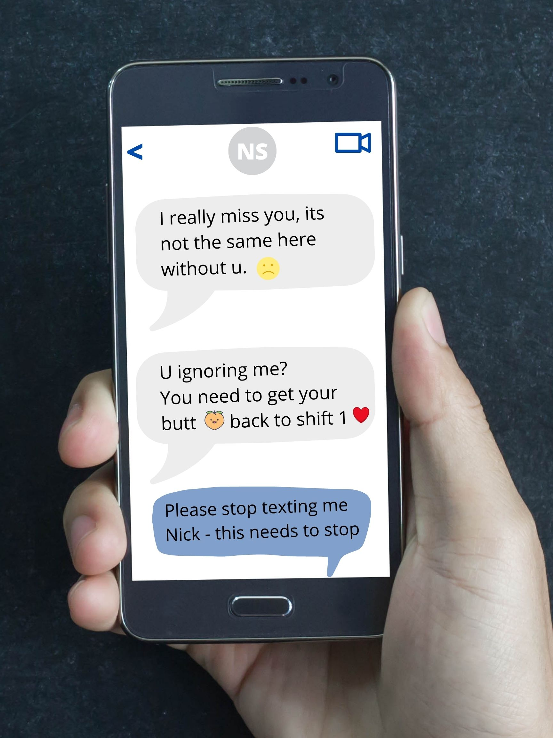
Investigation Scenario - Nick’s Interview
Joyce asks Nick about the text messages that he has sent
Nick looks down and looks a little flustered, when he looks up his face is red.
“Are these from Stephanie? We do have a lot of banter we always have had, she likes to tease and play around, she can be a bit of a minx.”
“That is just the way it is around here, always has been, it is only fun. If this is what the allegations are based on then it is a joke, we all act like this.”
“I think Stephanie only wrote about me stopping incase her husband saw it.”
“Am I getting fired?”
“We are in the process of the investigation, to ensure that the investigation is conducted thoroughly. We will be in touch with you as soon as possible.”
(Joyce reiterates confidentiality and Non-retaliation policy)

Slide 46
POLLING QUESTION 8
Do you think there were any concerns regarding retaliation for reporting a concern raised in the scenario?
Yes
No

Slide 47
Non-Retaliation Policy
We have referenced the Non-retaliation policy throughout this presentation.
As the investigator you should ensure that the parties involved in the investigation are fully aware of the policy, the importance and potential ramifications of breaching the policy.

Slide 48
POLLING QUESTION 8 - Answer
Do you think there were any concerns regarding retaliation for reporting a concern raised in the scenario?
Best answer would be 1. Yes
Catherine during her second complaint mentioned that she felt Nick’s behaviour had worsened since she raised the complaint to Joyce.
There are concerns that some witnesses are reluctant in talking for fear of losing their jobs.
Fear of retaliation is real – we should not underestimate how this can impact behaviour and a speak up culture.

Slide 49
Preparing the Report
Once you have completed the investigation you should prepare a written report of your investigation
Who should prepare the report?
When do you start writing it?
What should it contain?
Overview/summary complaint
Description of the investigative steps taken (people interviewed, documents reviewed, etc)
Statements and analysis of the facts
A review of applicable company policies and rules involved.
Conclusions reached

Slide 50
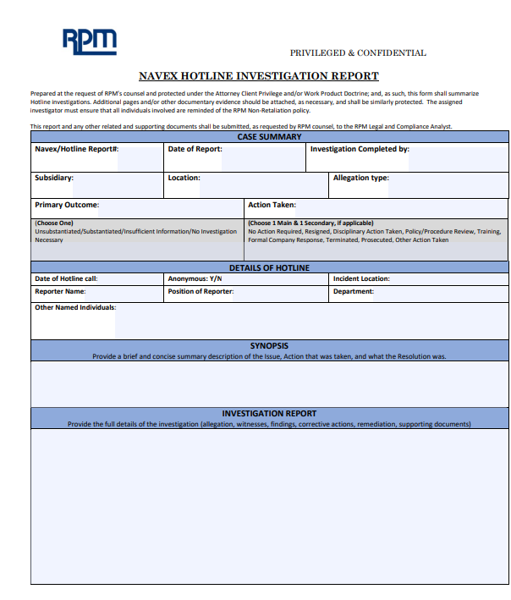
Preparing the Report
Report Should be Professional and Unbiased
Don’t slant the evidence and exclude relevant evidence that might appear to contradict the conclusion.
Don’t give the appearance of being one sided. Write clearly, objectively and support your statements with facts. (quotes, documents, records) and attached exhibits as appropriate
Do not appear overemotional.
Do not speculate, or exaggerate and only include necessary, pertinent information.
Remember that the report needs to be accurate and complete and may very well end up being introduced into evidence if a subsequent lawsuit or government action is involved. Most reports are privileged and confidential, but there may be certain occasions we waive the privilege.

Slide 51
POLLING QUESTION 9
What recommendations do you think Joyce should make in her report?
Termination
Other disciplinary action
Training
No action required

Slide 52
Preparing the Report
Report other considerations
Discuss recommended action with decision makers after investigation is concluded but before inserting it into the report. The decision maker may have some good ideas on how to address the issue.
Consider separating the recommended action from the report.
Make sure drafts are marked as drafts to avoid confusion
Mark all as confidential to protect as much as possible.
Mark attorney/client privileged or Attorney Work Product as appropriate
Who should/must be given a copy of the report?
Decision makers
Accused? Accuser

Slide 53
POLLING QUESTION 9 - Answer
Recommendations in a report can often be difficult, depending on the evidence gathered and available to the investigator.
It is important as the investigator that you discuss the findings and potential recommendations with the decision maker to ensure parties are aligned as possible.
What recommendations do you think Joyce should make in her report?
Termination
Other disciplinary action
Training
No action required
In this case it is likely that Nick may be given a written warning and require mandatory training on sexual harassment.
If you have a situation where there is a conflict on the potential actions/ remediations, be sure to consider all the options, if you are still concerned contact the Legal and Compliance team for advice.

Slide 54
Taking Appropriate Action
Depending on the outcome of the Investigation it is important that the company take appropriate action.
If the investigation uncovers wrongdoing the Company must take reasonable and appropriate remedial and disciplinary action depending on the conduct or issues involved
With respect to the individuals involved
On a company wide scale if the investigation uncovers a failure to follow or train on company’s Polices. For example, in an incident of sexual harassment, action should not only be taken with regard to the harasser, but if the investigation concludes that training was inadequate, then executives, managers and employees should all be trained.
Failure to take corrective action is wrong and could prove costly.
Ensure remediation is followed through and in a timely manner.

Slide 55
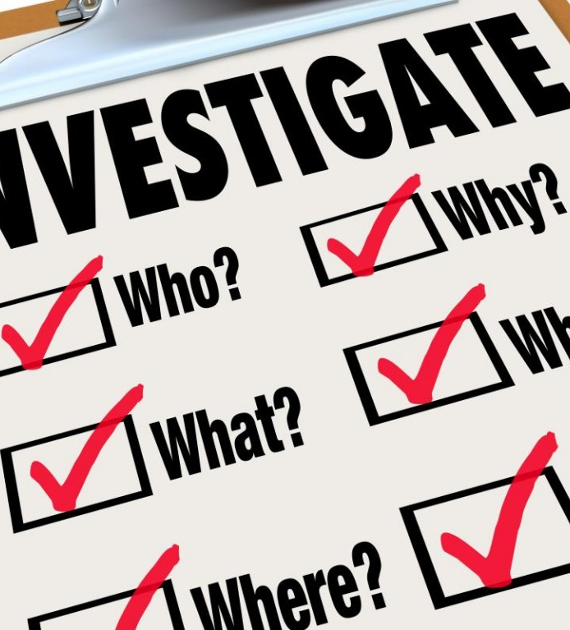
Other issues to consider….
Always be cognizant of the federal, state and local laws that could apply to you and the employees.
Collective bargaining agreements and laws applying to unionized work forces can change a lot of this.
Remember RPM’s reportable events policy.
Some activities may involve mandatory government disclosure.
Other Countries may and most likely do have much stricter laws to protect employee rights and privacy.
Remember the duty to preserve, but also remember company document retention/destruction policy
Consider whether there are any red flags during the investigation that may require follow up.

Slide 56
Thank you

