Slide 1
RPM 2022 Compliance Meeting

Slide 2
Presenters
Rusty Gordon, VP & Chief Financial Officer
Mike Laroche, VP Controller & Chief Accounting Officer
Bryan Gillette, Senior Director – Internal Audit & Chief Audit Executive
Live Q&A:
Paul Heming, Director of Accounting
Cheriece Boyd, Director of Internal Audit
Shelley Earl, Director of Global Compliance

Slide 3
Why are we here? – Rusty Gordon
Accounting is a Team Sport!
We need to work together.
You don’t need to be an accountant – you just need to know when to call the accountants.

Slide 4
What are the Rules? – Mike Laroche
Accounting Standards Codification (ASC) 606 “Revenue from Contracts with Customers”
When and how to recognize revenue.
Establishes 5 Steps.
Step 1
An Agreement with a Customer
Contract
Sales Order
Step 2
Identify Commitment (Promises)
Deliver Goods
Perform Services
Step 3
What is the Price?
Step 4
Assign price to the Promises
Step 5
Satisfy the Promises = Recognize the Revenue
What does it mean to “recognize revenue”?
We have met the promises to our customer (for example delivered the goods ordered based on the agreed upon shipping terms).
Satisfy the Promises = we can record the revenue in the financial statements.

Slide 5
What are the Rules? – Mike Laroche
What else do we need to do other than fulfill the promises?
Get Paid!
Make sure the customer has been vetted – follow good credit processes
Due Diligence (World Check)
Credit worthiness (D&B)
Consider payment history
Consider getting paid in advance where possible and where risks exist
Are the rules different based on the type of revenue?
Yes – Some of our main types of revenue streams can have different accounting:
Turnkey projects
Materials only sales
Other more unique products such as warranties

Slide 6
What are the Rules? – Mike Laroche
RPM Companies are required to complete a Revenue Recognition Questionnaire (RRQ) on a quarterly basis.
These questionnaires are attested to by GM/President/highest ranking Salesman & CFOs at the Operating Company and Group Level.
Used to monitor RPM’s compliance with the Revenue Recognition Standard
Provides information about an arrangement that:
Describes the facts and circumstances in new sales arrangements
Enables a conclusion as to whether the accounting treatment is correct
Provides information about the materiality of the arrangement
Communication to Operating Company and Group Leadership as to new sales arrangements is critical to ensure the RRQ’s are accurate.

Slide 7
Examples – Bryan Gillette
Example #1 – “Supply & Apply”
Background
Contract specifies RPM Company completes a waterproofing project.
Customer will pay RPM Company 50% of the full contract value upon delivery of the materials to the job site.
RPM Company is responsible for completing the project using our proprietary application process and machines.
Accounting
Revenue must be recognized over time based on the project completeness – not necessarily when the job is invoiced, or product delivered to the site.
Takeaway
Invoicing is not a trigger for Revenue Recognition.
Delivery of materials isn’t a trigger for Revenue Recognition for turnkey project.

Slide 8
Examples – Bryan Gillette
Example #2 – Advances
Background
RPM Company enters into a contract to sell finished product to Customer.
Terms are FOB Shipping Point.
Customer agrees to pay RPM Company 10% in advance to cover certain manufacturing costs.
Remaining 90% will be billed when product is shipped.
Accounting
The cash received is a liability (deferred revenue) as the Company hasn’t fulfilled our promise to deliver goods.
Revenue will only be recognized when the product is shipped.
Takeaway
Cash is hand does not mean revenue should be recognized – we need to fulfill the promises in the contract.

Slide 9
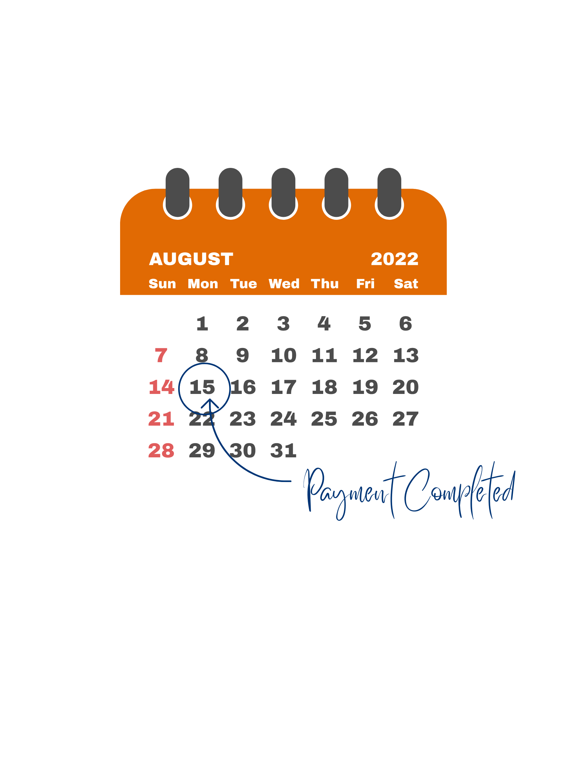
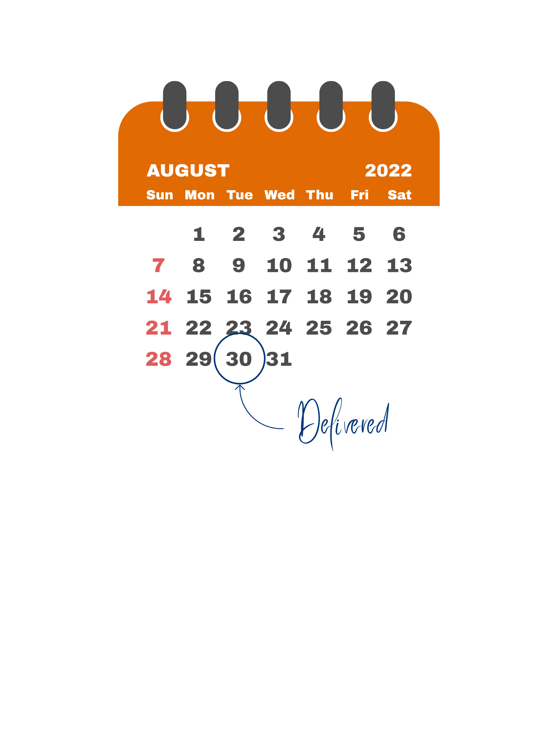
Examples – Bryan Gillette
Example #3 – Shipping Terms
Revenue should be recognized based on shipping terms and transfer of ownership
In this example the revenue should be booked in August despite the order being received in July
Takeaway
The Order does not trigger Revenue Recognition

Slide 10
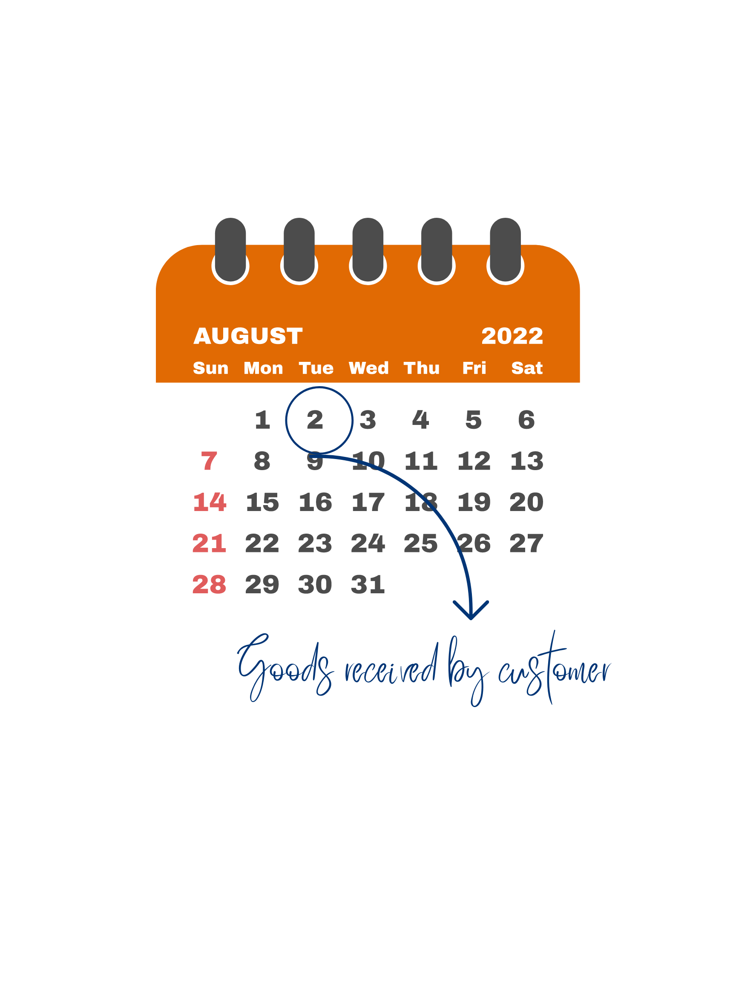
Examples – Bryan Gillette
Example #4 – FOB Destination
Background
Product is sold FOB Destination terms.
This means transfer of ownership does not occur until product is received by the customer.
Accounting
Revenue cannot be recognized until it is received by the customer
If the System automatically records revenue when product is shipped – Accounting must reverse a portion of revenue at month end accounting for the shipping time.
Revenue in this example should be recorded in August
Takeaway
Be aware of shipping terms – they are the key to revenue recognition timing

Slide 11
Examples – Bryan Gillette
Example #5 – FOB Origin/Shipping Point
Background
Product is sold FOB Origin/Shipping Point terms.
This means transfer of ownership occurs when the product leaves the RPM Company Warehouse.
Accounting
Revenue should be recognized upon shipment.
Analysis may need to be done to record items that may be “shipped not billed” at month end, if the product has shipped by the system has not yet recorded the shipment/generated the invoice.
Takeaway
Be aware of shipping terms – they are the key to revenue recognition timing

Slide 12
Examples – Bryan Gillette
Example #6 – Inconsistent Shipping Terms
Background
The Customer’s Purchase Order (contract) indicates sale is FOB destination (transfer of ownership when product arrives at customer)
The Bill of Lading (RPM Company’s system generated) indicates the sale is FOB shipping point (transfer of ownership when product is shipped).
RPM Company recognized revenue at time of shipment.
Accounting
A purchase order is typically viewed as a contract – if there is an agreed upon change in the shipping terms it needs to be documented and agreed to by both parties – otherwise the PO terms will likely take precedence.
In this case, the revenue was recognized before it should have been.
Takeaway
Look for any inconsistencies – make sure all parties are in agreement with the shipping terms.

Slide 13
Examples – Bryan Gillette
Example #7 – Purchase Order Fraud
Background
RPM Company received an unsolicited sales inquiry from a large corporation that was not an existing customer.
Customer ordered an unusually large quantity of one product type.
Credit check was performed on the customer, references were obtained but not checked.
No face-to-face contact with customer – all over email (customer has a Gmail address).
What Happened
RPM Company shipped the goods to requested location and invoiced the customer.
Customer did not pay, collection calls not returned.
It was determined the individual placing the order was fraudulently pretending to work for this large corporation.
Key Point
If it sounds too good to be true it probably is!
- Do your due diligence, ask questions, validate references

Slide 14
Examples – Bryan Gillette
Example #8 – Bill & Hold
Background
Customer calls RPM Company on February 27 and says it would like to order $100k of merchandise but it does have the warehouse space so can we hold the product for them and deliver it in April.
RPM Company has the product on hand and sets it aside in the factory on February 27 marking it with the customer’s name.
RPM Company would like to recognize the $100k in February.
Accounting
Likely this revenue cannot be recorded until it is shipped/delivered to the customer.
There are limited circumstances where a company may record this revenue as a “bill & hold” arrangement. Formal agreements would need to be in place and reviewed by Group Accounting and potentially RPM Corporate Accounting.
Bill & Hold arrangements must be disclosed on the quarterly Revenue Recognition Questionnaire.
Takeaway
Revenue can rarely be recorded in “bill & hold” situation – consult Accounting.

Slide 15
Examples – Bryan Gillette
Example #9 – Open Ended Payment Terms
Background
RPM Company “needs” additional revenue to “meet their numbers” at fiscal year end.
RPM Company calls certain customers and offers to sell and ship them product before fiscal year end, telling the customer they can pay for the product “whenever they want”.
Accounting
Receivables must be assessed for collectability and are current assets (meaning are expected to be paid within the next 12 months).
Open ended payment terms may be indicative that the sale is not legitimate or collectible.
Takeaway
Any unusual sales practices, promotions or extended terms should be reviewed with Accounting.

Slide 16
Conclusion – Mike Laroche
Revenue Accounting rules can be complex.
Revenue can only be recognized when the accounting requirements are fully met.
Cash received and/or the ability to invoice per a contract does not necessarily mean that revenue should be recognized.
Unfortunately, we have seen instances of fraud at RPM related to improper revenue recognition – this is a key area of focus for our external auditors (Deloitte).
Whether you are in finance or sales – you are a key part of the process to ensure RPM’s revenue practices are in line with the accounting rules.
If you have questions/concerns about a specific transaction, process or policy – reach out to your Company CFO, Group CFO, Corporate Finance or Internal Audit.

Slide 17
Resources
RPM Resources
Name | Role | Email
Rusty Gordon | Chief Financial Officer | rgordon@rpminc.com
Mike Laroche | Chief Accounting Officer | mlaroche@rpminc.com
Bryan Gillette | Chief Audit Executive | bgillette@rpminc.com
Shelley Earl | Director Global Compliance | searl@rpminc.com
Paul Heming | Director of Accounting | pheming@rpminc.com
Cheriece Boyd | Director of Internal Audit | cboyd@rpminc.com
Group Resources
Name | Role | Email
Jaime Brink | CPG CFO | JBrink@tremcoinc.com
Don Harmeyer | Consumer CFO | DHarmeyer@rustoleum.com
Mike Spinelli | PCG CFO | mike.spinelli@rpmpcg.com
Neil Smith | SPG CFO | nsmith@rpmspg.com

