Slide 1
RPM International Inc. Compliance Audits
Overview

Slide 2
RPM Internal Audit Department
Ed Moore
Sr. Vice President, General Counsel & Chief Compliance Officer
Audit Committee of the
Board of Directors
Bryan Gillette
Senior Director - Internal Audit Chief Audit Executive
Tracy Crandall
Vice President Compliance & Associate General Counsel
Mike Metivier
Director of IT Audit
Cheriece Boyd
Director of Internal Audit
Brian Frasier
Director of Compliance Audit
1 Senior and 1 Staff IT Auditor
3 Audit Managers, 4 Senior Auditors & 5 Staff Auditors
Carrie Rogers
Audit Manager

Slide 3
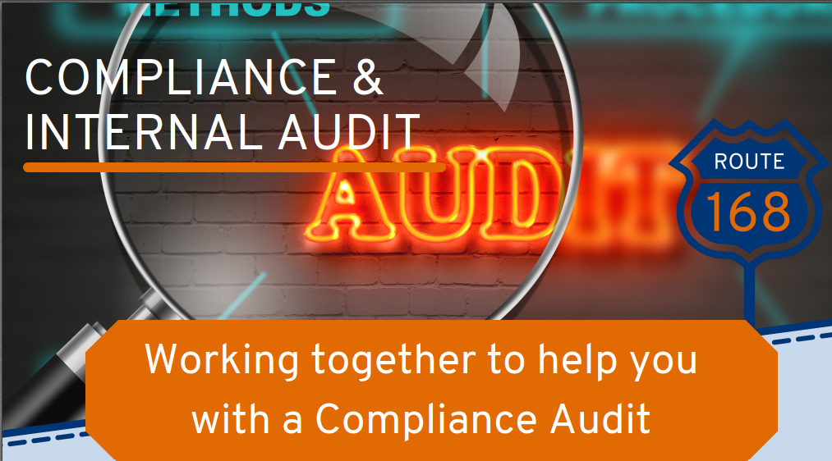
Compliance Audit

Slide 4
RPM Compliance Audit
What is a Compliance Audit?
A Compliance Audit is a review of a company’s compliance with various policies and procedures including RPM’s Code of Conduct – The Values & Expectations of 168. Compliance Audits are designed to help the business identify risks and meet their objectives.
Why is in Important?
Risks are everywhere. From Fraud & Corruptions to Conflicts of Interest & Data Privacy. A compliance issue can have tremendous impact that may affect a Company’s financials, reputation, and culture. A Compliance Audit can help identify risks, provide training, and ensure our companies are operating with ethics and integrity.

Slide 5
Compliance Audit Plan: Overview
Steps:
Planning & Scoping
Testing & Analysis
Fieldwork
Reporting
Areas of Focus:
Culture
Policy/Procedures & Training/Awareness
Finance
Third-Party Management
Human Resources
Scope​:
Each compliance audit is scoped based on the nature of the business being audited.

Slide 6
Culture
Management Tone at the Top
Decisions on Risk, Business Pressures & Speak Up Culture
HR Talent Practices
*Surveys

Slide 7
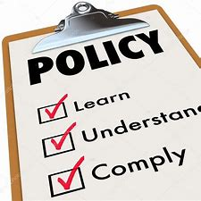
Policy/Procedures & Training/Awareness
The V&E of 168
Company specific policies and handbook
RPM Global Policies:
Conflicts of Interest
Gifts, Entertainment & Donations
Hotline and Non-Retaliation
Data Privacy
Third-Party Due Diligence
Reportable Events
Use of Cash

Slide 8
Finance
Travel & Expense
Gifts, Entertainment & Donations
Bank Statements
General Ledger
Company Credit Cards and Purchase-Cards
*Review of financial controls
Disbursements and approvals
Petty Cash
Commissions

Slide 9
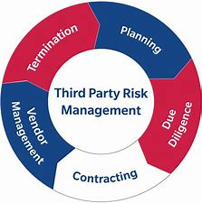
Third-Party Management
Third-Party Onboarding
Third-Party Continuous Monitoring
Third-Party Payments
Distributor relationships
Customer Pricing

Slide 10
Human Resources
Payroll
Time & Attendance
Employee Complaint & Investigation Process
Temp worker employment
Onboarding & Exit Process

Slide 11
Compliance Audit Themes
Of the Compliance Audits completed so far, some common trends have emerged:
RPM Global Policies
Conflicts of Interest
Travel & Expense
Third Party Due Diligence
Purchase Card Reviews

Slide 12
Compliance Audits

